Slide 1
Section Divider Slide

Slide 2
Microsoft Azure Governance Immersion Day
Notes:
Add name of primary proctor and their tile to this slide

Slide 3
What is Governance?
Establishment of policies, and continuous monitoring of their proper implementation, by the members of the governing body of an organization[…]¹
¹Source: BusinessDictionary

Slide 4
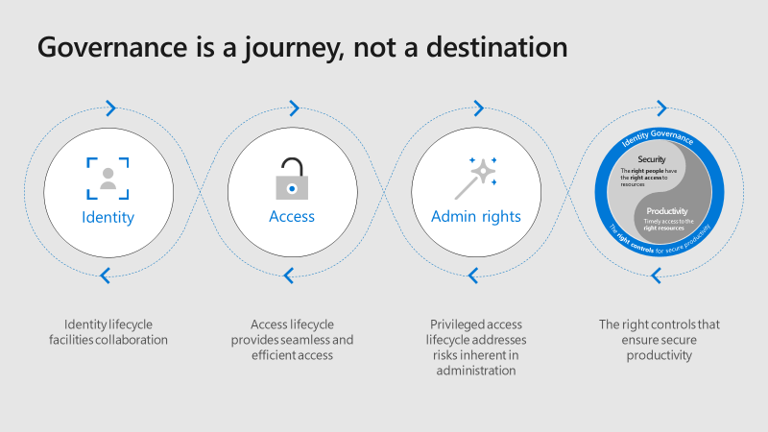
Source: Microsoft Ignite 2018 BRK3242
Notes:
No organization has ever gotten to a point where they feel like they are done with governance. The rapidly changing nature of the technology landscape ensures that there will always be new regulations to enforce, existing policies to be re-evaluated, and new security policies to be implemented as users change their behavior.

Slide 5
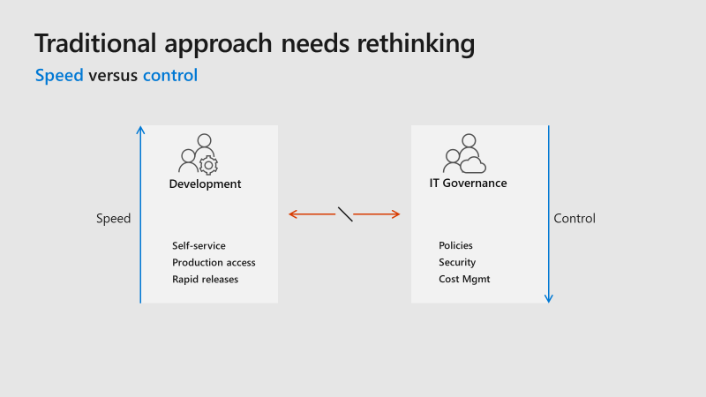
Source: Microsoft Ignite 2018 BRK2021
Notes:
Speed versus control is the eternal battle being fought between development teams and the team(s) responsible for the security and governance of the environments. Developers want the access they believe they need, right now, and they want to be trusted to be granted the ability to go as fast as possible. The Governance teams are concerned with ensuring the security of the organization, that costs are within acceptable limits, and that they have insight into what people are doing in the environment (no surprises!).

Slide 6
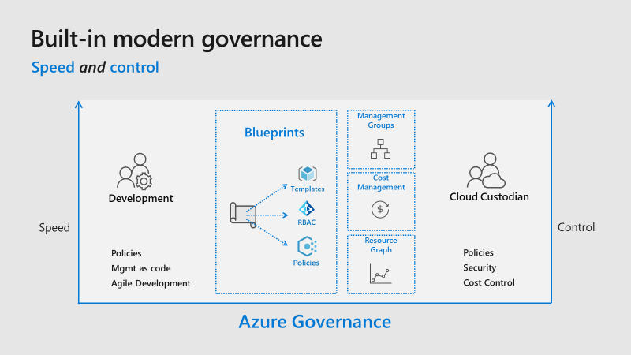
Source: Microsoft Ignite 2018 BRK2021
Notes:
A Cloud Custodian is an individual or a team in an organization concerned with IT Governance of the organization’s cloud environments. Talk through each one of the sections in the middle at a high level. Note that Azure Resource Graph is not covered in this Gameday.
Azure Resource Graph: Azure Resource Graph is a service in Azure that is designed to extend Azure Resource Management by providing efficient and performant resource exploration with the ability to query at scale across all subscriptions and management groups so that you can effectively govern your environment. These queries provide the following features:
Ability to query resources with complex filtering, grouping, and sorting by resource properties.
Ability to iteratively explore resources based on governance requirements and convert the resulting expression into a policy definition.
Ability to assess the impact of applying policies in a vast cloud environment.

Slide 7
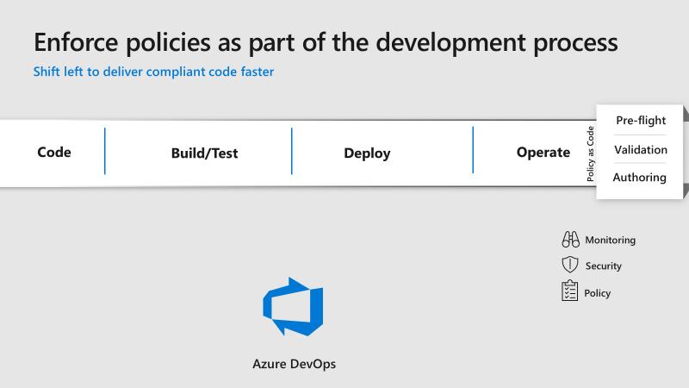
Source: Microsoft Ignite 2018 BRK2021
Notes:
Current situation for most organizations. Policy enforcement, authoring, testing, etc. happen after the code is deployed. We need to shift left to help deliver compliant code faster.

Slide 8
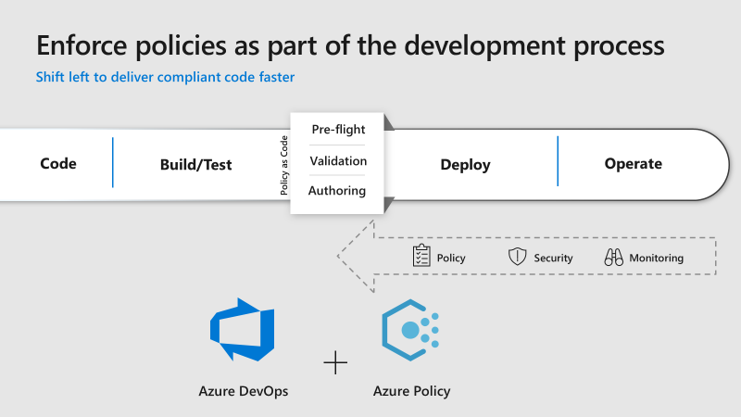
Source: Microsoft Ignite 2018 BRK2021
Notes:
This is what shifting left looks like

Slide 9
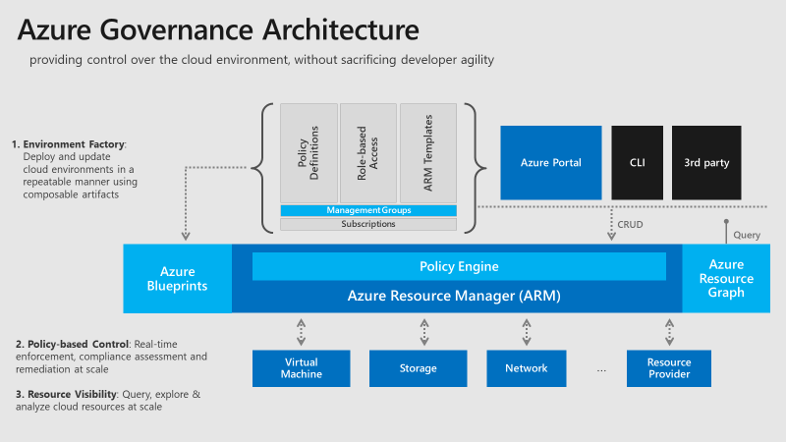
Source: Microsoft Ignite 2018 BRK3062
Notes:
Big picture of how all the pieces fit together. Now, let’s get started talking about how we get started with the building blocks for Azure Governance.

Slide 10
Organization Hierarchy
Notes:
The basis of the Enterprise Scaffolding strategy is determining the organization hierarchy

Slide 11
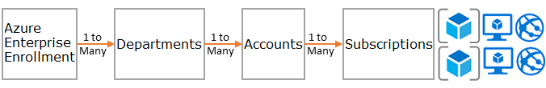
Organization Hierarchy
The foundation of Azure is the hierarchy and relationship of the Azure Enterprise Enrollment through to subscriptions and resource groups. The enterprise enrollment defines the shape and use of Azure services within your company from a contractual point of view. Within the enterprise agreement, you can further subdivide the environment into departments, accounts, and finally, subscriptions and resource groups to match your organization's structure.
Notes:
Another way to think about Organization Hierarchy is billing hierarchy

Slide 12
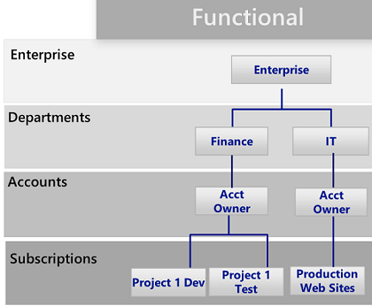
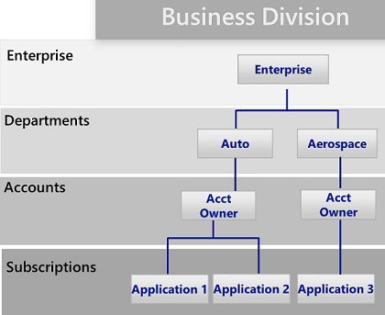
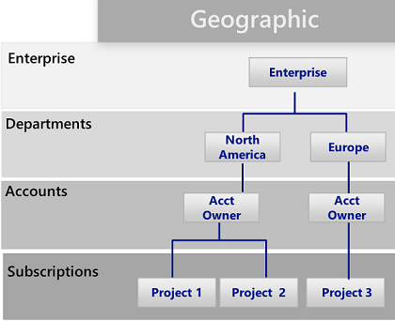
Organization Hierarchy – Example 1
Notes:
There are 3 common patterns: Functional, Business Unit & Geographic. Emphasize there is no “one size fits all” and it is highly dependent on each organization. Does the current on-premises hierarchy makes sense for Azure and a Cloud world?

Slide 13
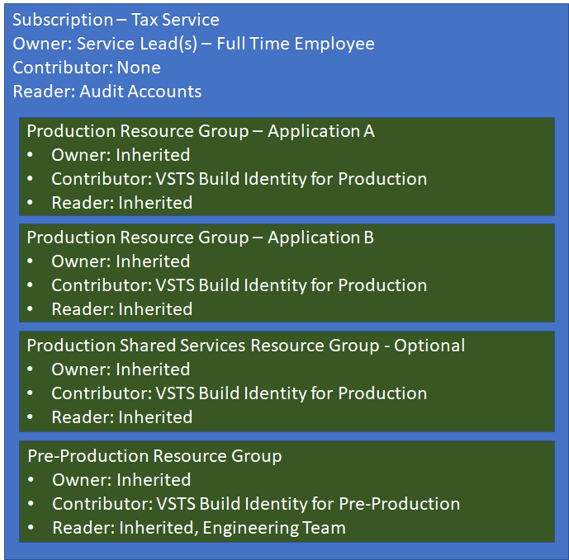
Organization Hierarchy – Example 2
Notes:
This is an example from Microsoft of how on of their internal development teams setup their environment
Point out the Subscription and its associated roles.
Within the Resource Groups above the typical components in each resource group would be the Azure components used to build the specific services for that application
Point out the Shared Services Resource Group (Log Analytics, vNets, Blob Storage, etc)

Slide 14
Organization Hierarchy Challenge
Plan First, Act Second!
Challenge:
What could your organization’s Azure Hierarchy look like?
Should it “match” your on-premises hierarchy?
Empower people; trust instead of control
The organization hierarchy has a large impact on upcoming challenges, take your time!
Notes:
Pound home the empower people, trust instead of control comment. It only shows up on this slide but applies to EVERYTHING in this Gameday.
Try to avoid looking up existing patterns and practices guidelines for how people do this. Think! What makes sense for your organization?
You will want to follow the Enterprise -> Department -> Account -> Subscription hierarchy, however what makes up each one of those things (and how many) is entirely up to you
Whiteboard / Draw / Visio out possible structures until your team has one they agree on

Slide 15
Organization Hierarchy Results
What did each team come up with?
What did you learn?
Notes:
Are there things for Sirius or the customer to follow up on? Make sure those get recorded.

Slide 16
Azure Management Groups

Slide 17
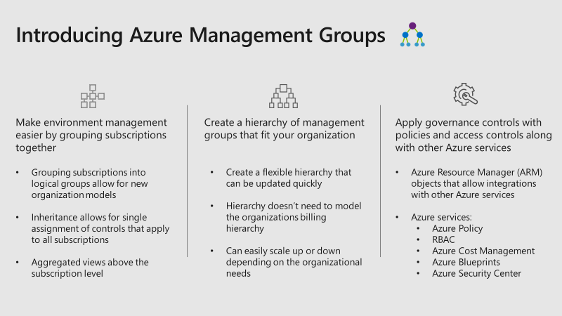
Management Groups
Notes:
Make sure to highlight that the Management Groups hierarchy doesn’t need to model the organizations billing hierarchy.

Slide 18
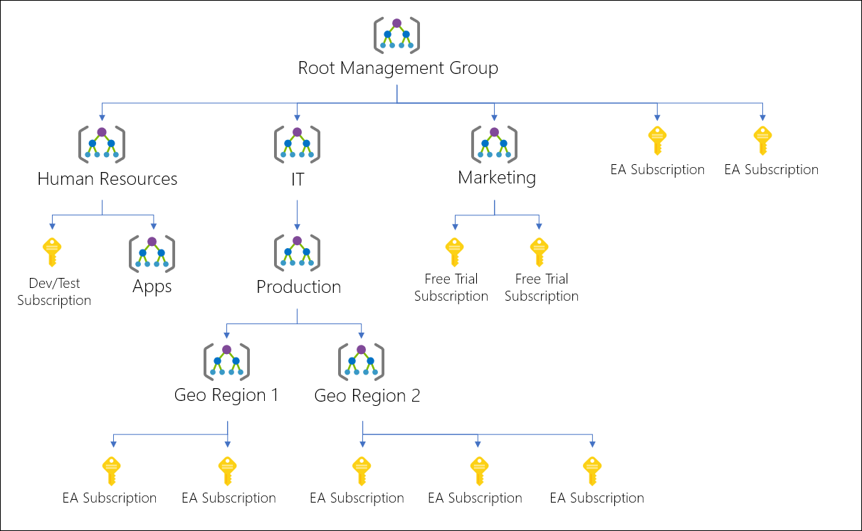
Management Groups: Example 1
Notes:
The Root Management Group exists in every subscription and cannot be modified.

Slide 19
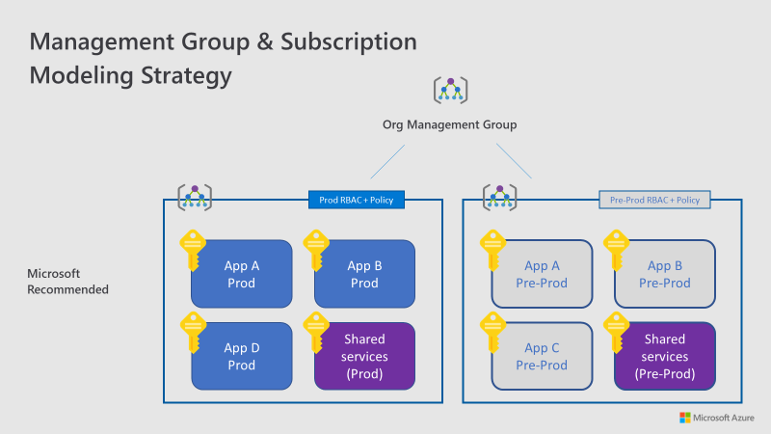
Management Groups: Example 2
Notes:
The keys are subscriptions, the bigger box is the Management Group encompassing all the subscriptions which is where the policies and RBAC are applied.

Slide 20
Management Groups: Things to Think About
Create hierarchies so that you can apply policies later on in a way that makes sense.
Management groups allow you to create a hierarchy that is separate from your billing hierarchy, solely for efficient management of resources.
Management groups can mirror your billing hierarchy and often enterprises start that way.
The power of management groups is when you use them to model your organization where related subscriptions — regardless where they are in the billing hierarchy — are grouped together and need common roles assigned as well as policies and initiatives.
Think about creating management groups to provide users access to multiple subscriptions through one group.

Slide 21
Management Groups: Things to Think About
Policies applied at the Root Management group apply to all subscriptions and management groups below them (and so forth).
Each Management Group tree can support 6 levels of depth.
Each Management Group and subscription can have only one parent.
Each Management Group can have many children.

Slide 22
Subscriptions

Slide 23
Subscriptions
When deciding on your Departments and Accounts (or management groups), you are primarily looking at how you're dividing up your Azure environment to match your organization.
Subscriptions are where the real work happens and your decisions here affect security, scalability and billing.

Slide 24
Subscriptions Structure Patterns
Application/Service: Subscriptions represent an application or a service (portfolio of applications).
Lifecycle: Subscriptions represent a lifecycle of a service, such as Production or Development.
Department: Subscriptions represent departments in the organization.
Notes:
We have seen examples of how to possibly lay out subscriptions already. The first two patterns are the most commonly used, and both are highly recommended. The Lifecycle approach is appropriate for most organizations.

Slide 25
Portal Demo
Notes:
Purpose here is to go into the portal and demo what the management group, subscription, resource group, resource hierarchy looks like so people can look at how this all eventually ties in together and what it looks like visually.

Slide 26
Management Groups & Subscriptions Challenge
Challenge:
What could your organization’s Management Group Hierarchy look like?
Should it “match” the organization hierarchy?
Empower people; trust instead of control
Include the subscription hierarchy in this design
Each team will use their Management Group & Subscription Hierarchy going forward in future challenges!
Notes:
Whiteboard / Draw / Visio out possible structures until your team has one they agree on

Slide 27
Management Groups & Subscriptions Results
What did each team come up with?
What did you learn?
Notes:
Are there things for Sirius or the customer to follow up on? Make sure those get recorded.

Slide 28
Resource Groups

Slide 29
Resource Groups
Azure Resource Manager (ARM) enables you to put resources into meaningful groups for management, billing, or natural affinity. Resource groups are containers of resources that have a common life cycle or share an attribute such as "all SQL servers" or "Application A”.
Like subscriptions, there are common patterns when creating resource groups and will vary from "Traditional IT" workloads to "Agile IT" workloads.
Notes:
"Traditional IT" workloads are most commonly grouped by items within the same life cycle, such as an application. Grouping by application allows for individual application management.
"Agile IT" workloads tend to focus on external customer-facing cloud applications. The resource groups often reflect the layers of deployment (such as a web tier or app tier) and management.

Slide 30
Resource Groups: Things To Know
All the resources in your group should share the same lifecycle. You deploy, update, and delete them together. If one resource, such as a database server, needs to exist on a different deployment cycle it should be in another resource group.
Each resource can only exist in one resource group.
You can add or remove a resource to a resource group at any time.
You can move a resource from one resource group to another group.
A resource group can contain resources that are located in different regions.
A resource group can be used to scope access control for administrative action (RBAC).
A resource can interact with resources in other resource groups. This interaction is common when the two resources are related but don't share the same lifecycle (for example, web apps connecting to a database).
Notes:
Point out that while RBAC can be scoped at the resource group (and individual resource level) the goal in this Gameday is to scope the policies and permissions at the Management Group level.

Slide 31
Resource Groups Challenge
Challenge:
What would could your organizations Resource Group structure look like?
Remember that your management group and subscription structure will affect the policies and access controls placed on the resource groups
How does this impact production and non-production environments?
How does this impact cloud born applications?
How does this impact a hybrid environment?
Notes:
If the groups feel that they need to go back and revisit any of the challenges previously done, encourage them to do so!
Whiteboard / Draw / Visio out possible structures until your team has one they agree on

Slide 32
Resource Groups Results
What did each team come up with?
What did you learn?
Notes:
Are there things for Sirius or the customer to follow up on? Make sure those get recorded.

Slide 33
Naming Conventions and Standards

Slide 34
Naming Conventions and Standards
Well-designed naming standards enable you to identify resources in the portal, on a bill, and within scripts.
You likely already have existing naming standards for on-premises infrastructure. When adding Azure to your environment, you should extend those naming standards to your Azure resources.
But only if it makes sense! If it make sense to change something, now is the time to change it!
Concentrate your naming standards on those resources that are more commonly used and searched for. All resource groups should follow a strong standard for clarity.
Notes:
Example: All resource groups should end in –rg.
Don’t give them any more examples than that.

Slide 35
Tags

Slide 36
Tags
Resource tags are tightly aligned with naming standards. As resources are added to subscriptions, it becomes increasingly important to logically categorize them for billing, management, and operational purposes.
Tags are used in many ways beyond billing and management, such as automation.
The recommended practice is to identify all the common tags at the enterprise level (such as ApplicationOwner, CostCenter) and apply them consistently when deploying resources using automation.
Notes:
Explain how Enterprise Level refers to the Organizational Hierarchy and Management Group structures created earlier

Slide 37
Tags: Things to Know
Each tag consists of a name and a value pair. For example, you can apply the name "Environment" and the value "Production" to all the resources in a production resource group.
Each resource or resource group can have a maximum of 15 tag name/value pairs.
Tags applied to the resource group are not inherited by the resources in that resource group.
How can we ensure Tags are applied at the resource level?
Notes:
The answer to the question is Azure Policy

Slide 38
Naming Conventions and Tags Challenge
Challenge:
Pick 1 Management Group, Subscription, Resource Group(s) from the previous challenge
What could your organizations Naming Standards and conventions look like for each component?
What could your Naming Standards look like for VMs, Virtual Networks, App Services and/or SQL Servers?
What are the tags that make sense for each component of the structure that you have created?
Are there any restrictions / limitations on the naming of resources?
Notes:
There is a whole document on the Azure docs site about Naming conventions for Azure resources. Reference the Proctor guide for it.

Slide 39
Naming Conventions & Tags Results
What did each team come up with?
What did you learn?
Notes:
Are there things for Sirius or the customer to follow up on? Make sure those get recorded.

Slide 40
Azure Policy

Slide 41
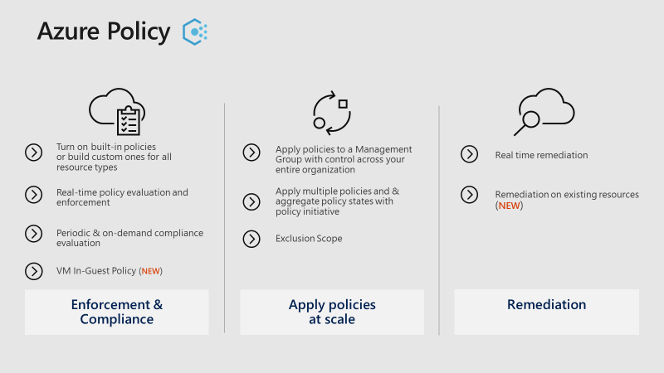
Azure Policy & Initiatives
Notes:
How are we going to enforce the naming standards, tagging policies, and many other things that we haven’t talked about yet? With Azure Policy!

Slide 42
Azure Policy & Initiatives
Azure Policy & Initiatives manage risk by enforcing rules (with effects) over the resources and services in your subscriptions.
Azure Initiatives are collections of policies that are designed to achieve a single goal. Azure policies and initiatives are then assigned to a resource scope to begin enforcement of the particular policies.
Policies and initiatives are even more powerful when used with the management groups mentioned earlier. Management groups enable the assignment of an initiative or policy to an entire set of subscriptions.
Notes:
A resource scope can be a management group, a subscription, or even a resource group
Assignments allow you to also exclude a sub-scope from the assignment of a policy. For example, if you deny the creation of public IPs within a subscription, you could create an assignment with an exclusion for a resource group connected to your protected DMZ.

Slide 43
Azure Policy & Initiatives: Common Uses of Policies
Geo-compliance/data sovereignty.
Azure has an ever-growing list of regions across the world. Enterprises often need to ensure that resources in a particular scope remain in a geographic region to address regulatory requirements.
Avoid exposing servers publicly.
Azure Policy can prohibit the deployment of certain resource types. It's common to create a policy to deny the creation of a public IP within a particular scope, avoiding un-intended exposure of a server to the internet.
Cost Management and Metadata.
Resource tags are often used to add important billing data to resources and resource groups such as CostCenter, Owner and more. Policies can enforce the application of resources tags to all deployed resources, making it easier to manage.

Slide 44
Azure Policy & Initiatives: Common Uses of Initiatives
Enable monitoring in Azure Security Center.
This is a default initiative in the Azure Policy. It enables policies that identify un-encrypted SQL databases, virtual machine (VM) vulnerabilities and more common security related needs.
Regulatory specific initiative.
Enterprises often group policies common to a regulatory requirement (such as HIPAA) so that controls and compliancy to those controls are tracked efficiently.
Resource Types and SKUs.
Creating an initiative that restricts the types of resources that can be deployed as well as the SKUs that can be deployed can help to control costs
Notes:
Slide hidden by default. Don’t want to offer too many examples. Use if you believe it’s necessary.

Slide 45
Azure Policy & Initiatives Challenge
Time to get our hands dirty!
Create a sample Management Group -> Resource Group(s) hierarchy for use to deploy resources into (but don’t deploy any resources)
Brainstorm a list of policies that is appropriate for each level of your org hierarchy, management group, subscription, resource group, etc.
How could those policies be rolled up to bigger initiatives?
Pick a handful of policies, create them, roll them into an initiative, and then deploy the initiative to an appropriate scope
Deploy some resources that you want to test with
Try to violate the policies you have created! Are they functioning as expected?
Notes:
What happens here is going to be specific to whatever they have come up with. If they have resource groups for dev – stage – prod, have them deploy all 3 under the management group (that may need to be created by the customer if they are using a production or other existing azure subscription)

Slide 46
Azure Policy & Initiatives Results
What did each team come up with?
What did you learn?
Notes:
Are there things for Sirius or the customer to follow up on? Make sure those get recorded.

Slide 47
Identity and Access Management

Slide 48
Identity & Access Management
One of the first, and most crucial, questions you ask yourself when starting with the public cloud is "who should have access to resources?" and "how do I control this access?"
Allowing or disallowing access to the Azure portal, and controlling access to resources in the portal is critical to the long term success and safety of your assets in the cloud.

Slide 49
Identity & Access Management
With role-based access control (RBAC), you can assign users to standard roles that provide common access such as "owner", "contributor" or "reader" or even create your own roles.
When implementing role-based access, the following are highly recommended:
Control the Administrator/Co-Administrator of a subscription as these roles have extensive permissions.
Use management groups to assign roles across multiple subscriptions and reduce the burden of managing them at the subscription level.
Add Azure users to a group (for example, Application X Owners) in Active Directory. Use the synced group to provide group members the appropriate rights to manage the resource group containing the application.
Follow the principle of granting the least privilege required to do the expected work.
Notes:
Empower people; trust instead of control

Slide 50
Identity & Access Management Challenge
Who should be the Administrators / Co-Administrators of each subscription you outlined previously?
Can these be grouped? Do new groups need to be created? Do they really need these permissions?
At what level can these subscription permissions be grouped into the Management Group layer?
What groups / individuals need permissions at the Resource Group level?
Can these be grouped? Do new groups need to be created? Who needs Create permissions? Who needs Read permissions?
Look at the existing Roles that are available. Does a custom Role for your organization make more sense? What permissions would this role need to include (use the official role definitions)?
Notes:
Emphasize that every effort should be made to use the built-in roles. Custom roles leads to role sprawl and add to the complexity of governing and managing the environment.

Slide 51
Identity & Access Management Results
What did each team come up with?
What did you learn?
Notes:
Are there things for Sirius or the customer to follow up on? Make sure those get recorded.

Slide 52
Azure Blueprints

Slide 53
Azure Blueprints – Why?
Customer Challenges:
No central way to compose and enforce what goes into or made available in a subscription
Challenging to setup foundational infrastructure
Subscription owners can modify resources and remove policies breaking best practices defined by Cloud Architects (for example)
No way to codify best practices

Slide 54
Azure Blueprints
Azure Blueprints enables cloud architects and central information technology groups to define a repeatable set of Azure resources that implements and adheres to an organization's standards, patterns, and requirements.
Azure Blueprints makes it possible for development teams to rapidly build and stand up new environments with trust they're building within organizational compliance with a set of built-in components -- such as networking -- to speed up development and delivery.
Notes:
“cloud architects and central information technology groups “ eventually ends up referring to a group of Cloud Custodians in an organization, whether they are officially named that or not
Important to note this isn’t just for development teams, although this is the biggest use case!

Slide 55
Azure Blueprints
Blueprints are a declarative way to orchestrate the deployment of various resource templates and other artifacts such as:
Role Assignments (IAM)
Policy Assignments (Azure Policy and Initiatives)
Azure Resource Manager templates
Resource Groups
Including a policy in a blueprint enables the creation of the right pattern or design during assignment of the blueprint. The policy inclusion makes sure that only approved or expected changes can be made to the environment to protect ongoing compliance to the intent of the blueprint.
Notes:
Highlight what ARM Templates are good for

Slide 56
Azure Blueprints Challenge
Using what you have previously created, create an Azure Blueprint and determine:
What Resource Group(s) should this blueprint create?
What Azure Resources should be deployed into each Resource Group?
What policies and initiatives belong in the Blueprint?
What RBAC belong in the Blueprint?
Notes:
Example: If the customer has decided they want production and pre-production resource groups per application, have them pretend they have to deploy the entire environment for a brand new application (production or pre-production) and model the blueprint around that

Slide 57
Azure Blueprints Results
What did each team come up with?
What did you learn?
Notes:
Are there things for Sirius or the customer to follow up on? Make sure those get recorded.

Slide 58
Questions, Comments, Next Steps

Slide 60
Header Only

Slide 61
Body Slide

Slide 62
Double Column Slide

Slide 63
Double Column with Header Slide

